Slide 1
Welcome
To Our
TRIVIA
NIGHT
Get your answer sheet from the host to join in.

Slide 2
Round 1
Common Knowledge
Not So
1) Where on the Human body is the skin the thinnest?
2) Which couple were known as ‘Bennifer’?
3) In bingo which number is ‘duck and dive’?
4) 'Call you up in the middle of the night, Like a firefly without a light" is the first line from which 1992 hit?
Did you know – Shakespeare invented over 1700 of our common words.

Slide 3
Round 1
Common Knowledge
Not So
5) What is the ship of the desert?
6) What family of plant is bamboo?
7) Which state is the setting for South Park?
8) What can be something you look at and also mean to look for something?
Did you know – Shakespeare invented over 1700 of our common words.

Slide 4
Round 1
Common Knowledge
Not So
9) What do you call Japanese food that is dipped in batter and deep fried?
10) What event caused twitter services to crash on the 25 th June 2009?
11) Where would you find a Platter, j-bar, bum, button or a Poma?
12) Name the senator that has resigned from the Labor frontbench following the revelation a Chinese company paid a personal bill?
Did you know – Shakespeare invented over 1700 of our common words.

Slide 5
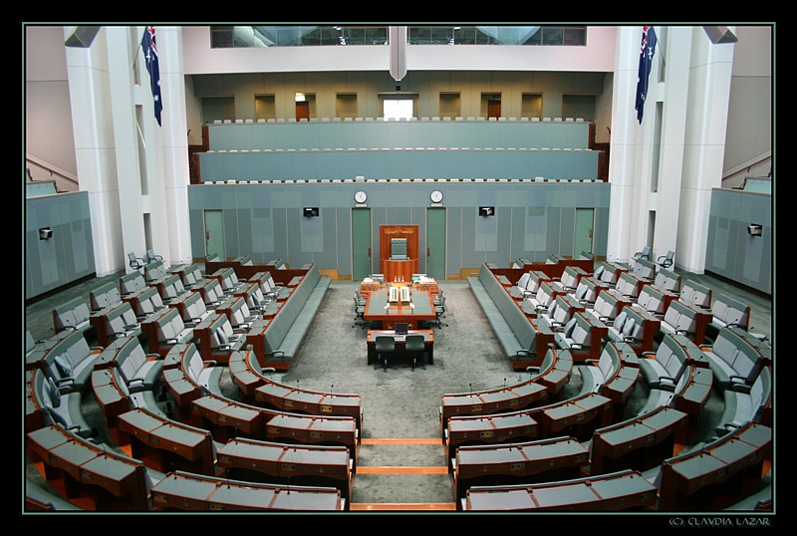
BONUS QUESTION!
Q) There are currently how many members of the House of Representatives?

Slide 6
Round 2.
Who, What, Where??
1) Which band featured the Starchild, the Demon, the Cat and the spaceman?
2) In 1975 who became the first non-European resident to win the World Championship for Irish dance?
3) What sort of speaker is named after a dog noise?
4) Which country’s name means ‘the low lands’?
Did you know – In military terms, a "klick" means a distance of 1000 meters

Slide 7
Round 2.
Who, What, Where??
5) Which super hero is known for their indestructible bracelets?
6) Which band is fronted by Paul Hewson?
7) Detective Axel Foley is a fictional character, portrayed by who?
8) What is Australia's number one selling supermarket product, outselling not only every other fruit and vegetable but every other supermarket line?
Did you know – In military terms, a "klick" means a distance of 1000 meters

Slide 8
Round 2.
Who, What, Where??
9) What is the only number that equals twice the sum of its digits? (digit means numerical symbol)
10) What can be a capital, a pepper and a Porsche?
11) What is the traditional name of Thai boxing?
12) What animal do conservationists say still face severe threats after the IUCN took the species off its endangered list?
Did you know – In military terms, a "klick" means a distance of 1000 meters

Slide 9
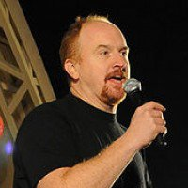
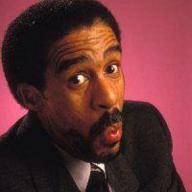
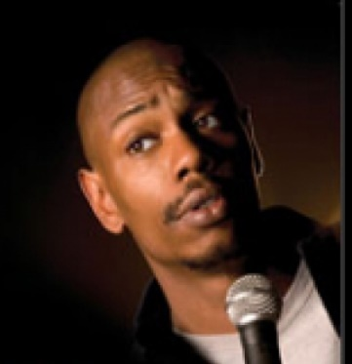
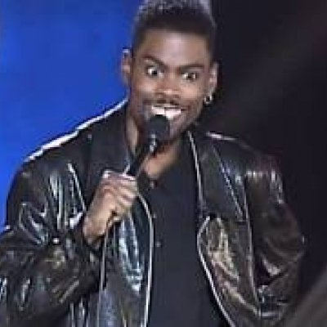
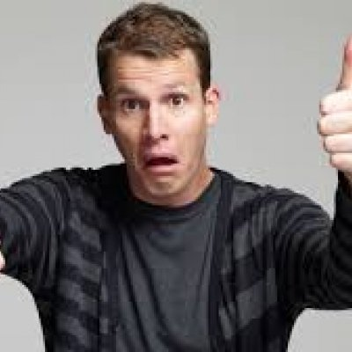
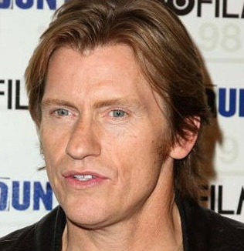
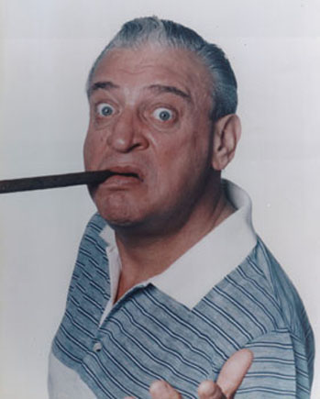
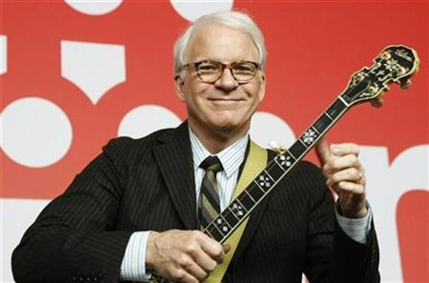
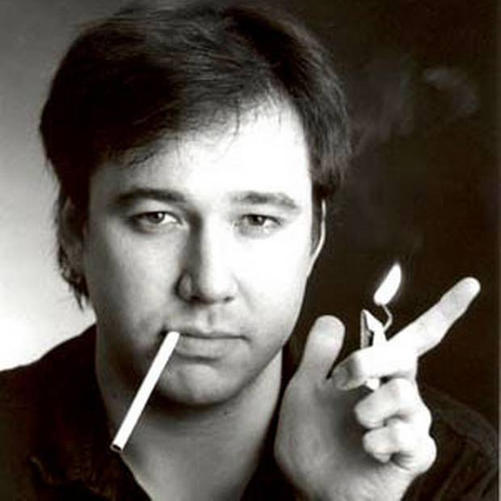
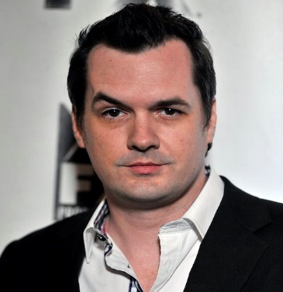
Name the famous Comedian..
1.__________
2.__________
3.__________
4.__________
5.__________
6.__________
7.__________
8.__________
9.__________
10._________
Team Name._____________________

Slide 10
Round 3 - WTF
What The Flip
1) Which is the only bird that can swim but not fly?
2) Egg yolks, English mustard, white wine vinegar, oil, salt and pepper. What are you making?
3) Which fictional character had a dog named Jip and a pig named Gub Gub?
4) Which word of Tongan origin means forbidden / unmentionable?
Did you know – Philadelphia was once the capital of the United States.

Slide 11
Round 3 - WTF
What The Flip
5) Which boy band featured three members of the Wilson family?
6) What are you calculating with the following 'Weight divided by height squared'?
7) What is the largest purpose built structure on earth?
8) Which is denser gold or silver?
Did you know – Philadelphia was once the capital of the United States.

Slide 12
Round 3 - WTF
What The Flip
9) Which musical instrument is a boys name said twice?
10) Which is the first animal in the dictionary?
11) Where did the Wizard of Oz live?
12) Australia has now notched up how many years without a recession?
Did you know – Philadelphia was once the capital of the United States.

Slide 13
Pick the Songs.
Name the Song & Band.
(Click Box to play)

Slide 14
Round 4
The Lucky Dip
1) What anagram of the word BEADIEST is a complex condition which can affect the entire body?
2) A photovoltaic module is more commonly known as what?
3) What is the name of the Jehovah’s Witness newsletter/illustrated religious magazine?
4) Most Caucasian babies are born with what colour eyes before their true eye colour reveals itself a few months later?
Did you know – A light year is equal to 10 trillion kilometres

Slide 15
Round 4
The Lucky Dip
5) What do you call an alloy that joins surfaces together?
6) Who carries out the instructions of a will?
7) What do you call someone who pens a book but lets someone else take the credit?
8) Which capital city is closest to the equator?
Did you know – A light year is equal to 10 trillion kilometres

Slide 16
Round 4
The Lucky Dip
9) If a house painter paints numbers on all the houses in a new estate from 1 to 100. How many times does he paint the number 9 in the process?
10) What is the common name for the electrically excitable cells of the brain which process data via electrical and chemical signals?
11) What is the star/middle square on a Scrabble board worth?
12) What actor was the narrator in the movie "The Royal Tenenbaums"?
Did you know – A light year is equal to 10 trillion kilometres

Slide 17
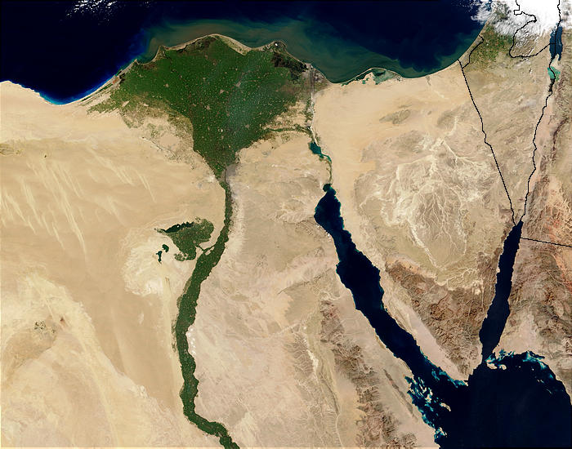
Jackpot Question!
Question: Which word describes a triangular or fan like river mouth?

Slide 18
TIE BREAKER
1) Common in Asian cooking what do you call clarified butter?
2) In 1905 the title ‘First Lord of the Treasury’ changed to what?
3) How many people survived the sinking of the Titanic?

Slide 19
Thanks for playing!
Book now for next week!

